Slide 1
meeting: smart transport
2019-03-17(一)
Reporters: 顏慷, 布駿霆

Slide 2
Outline
Motivation
System Overview
Android Application
Server
SUMO (simulation of urban mobility)

Slide 3


Real Life (Simplest scenario)
source
destination

Slide 4
Motivation
We current do not have driverless truck to send packages in the Taiwan city.
We want to develop a system which can simulate the real-world logistic condition on the scale of city.
With real-world logistic simulation, we can reduce the gap between the real logistic condition and imagination to improve user experience.
Our system also can provide a platform where we can add Expansion function and implement the algorithm.

Slide 5
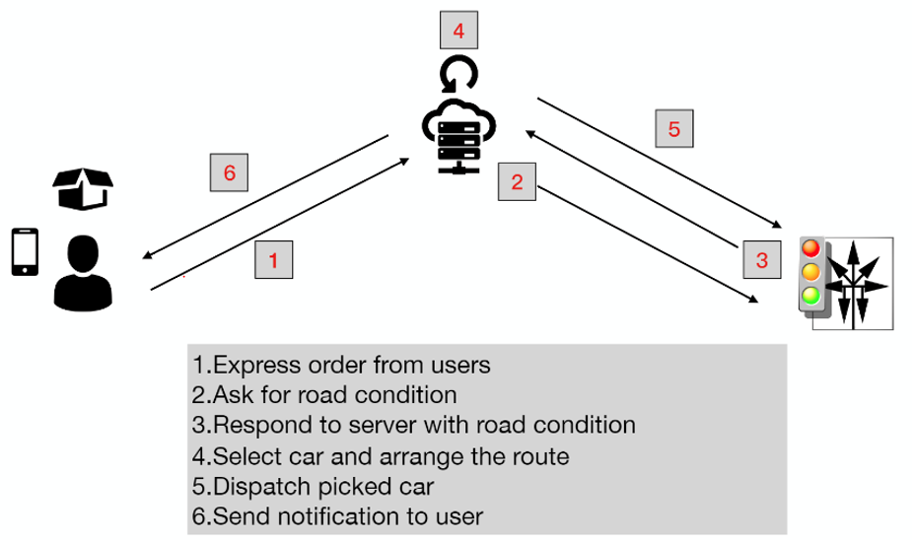
System overview

Slide 6
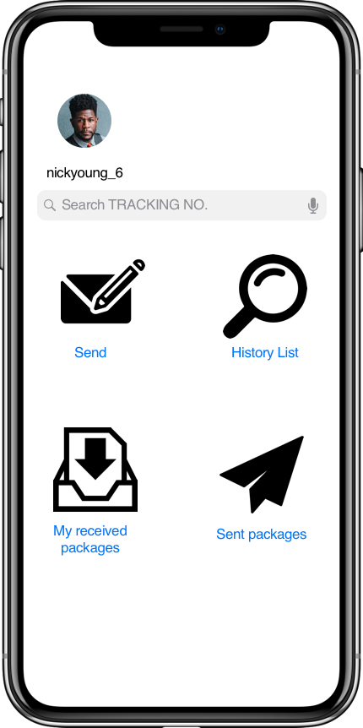
Main page of APP
User ID
SEND:
1.user能在android手機上，執行”Send“動作，手機把Order request傳送到server端
2.Server能正確接收該request
3.計算下單的起終點address，加入truck address data計算後，規劃出一條path

Slide 7
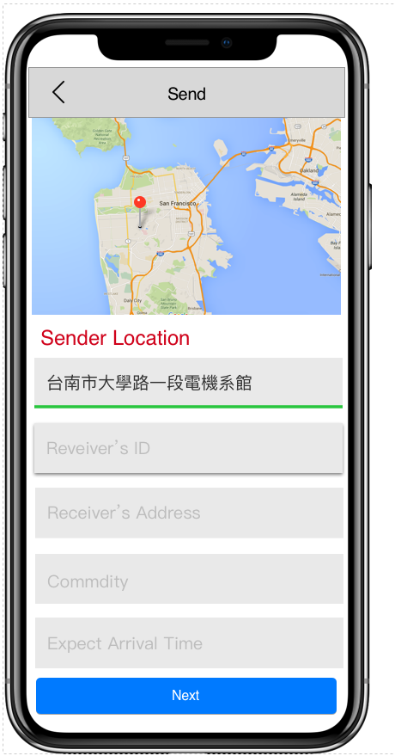
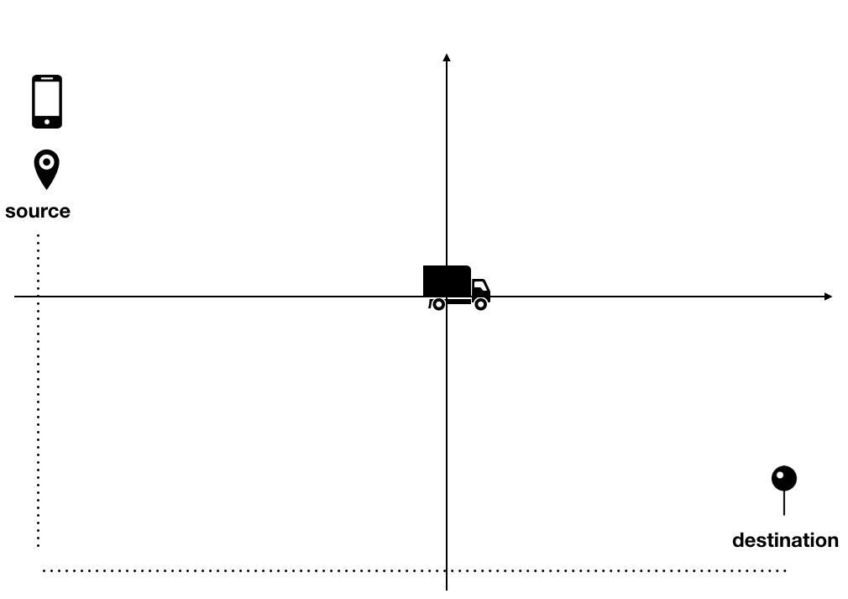
APP stage 1- 下單
1. 下單
2. 車子前往寄件人地點
3. 車已到寄件人位置，尚未收貨
4. 車已收貨，前往收件者位置
5. 車到達收件者位置

Slide 8
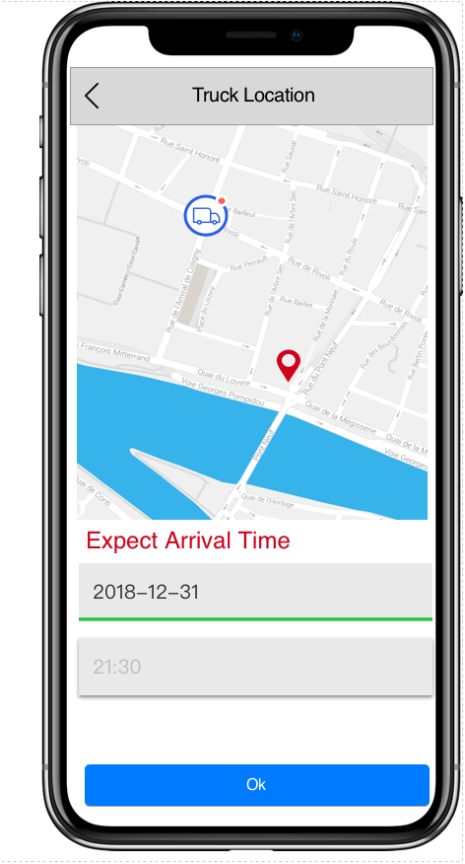
APP stage2- 車子前往寄件人地點
S: 能從”sent package”欄位，得知貨車位置與顯示“預估到達時間”
R: no reflection

Slide 9
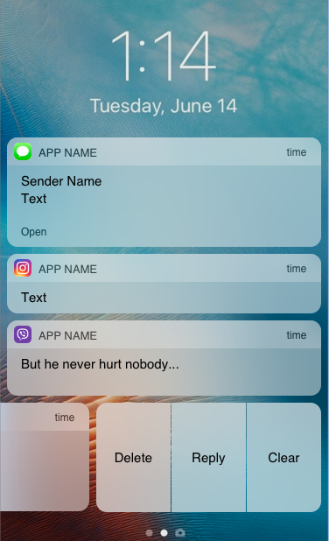



APP stage 3- 車已到寄件人位置，尚未收貨
S: 橫幅通知
R: No reflection
當車輛到寄件人位址

Slide 10
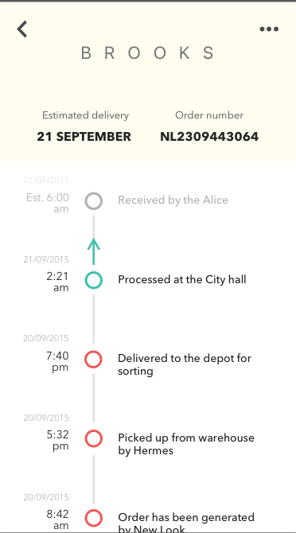
APP stage 4- 車已收貨，前往收件者位置
S: 能從“Sent package”，
手機顯示運貨資訊
R: 接收收貨通知

Slide 11
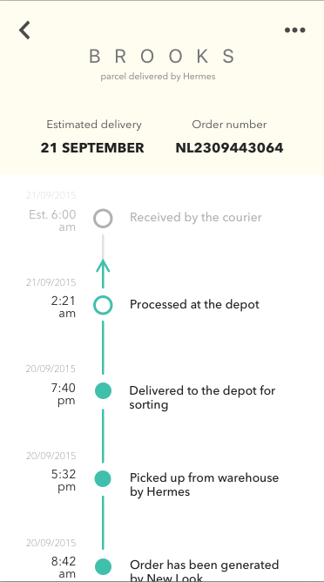
APP stage 5- 車到達收件者位置
S: 按下“Sent package”，
手機顯示運貨資訊，了解貨物運送成功
R: Server傳送橫幅通知給
Receiver，告知貨車已到達收件地址

Slide 12

Server
1
2
(利用PHP撰寫API) 接收android手機發送的送貨“訂單”需求，並在Order table建立訂單資料。
向SUMO要求road condition (包括車子與路面交通資料)。
以該貨車位置當作起點，寄件者位置為終點，以PHP程式規劃一條駕駛路徑，並發出派車命令給SUMO。
向android手機發送貨車的動態位置，使得手機能顯示貨車的即時位置。

Slide 13
SUMO
1. Create a new map like Tainan's map
2. Generate random cars in this area
3. Label the car with ID, velocity, current position and capacity of it
4. Send car Information to Web Server periodically
5. Receive the command from Server and dispatch the suitable car to user's location
6. Export the coming signals when the car arrived the destination

Slide 14
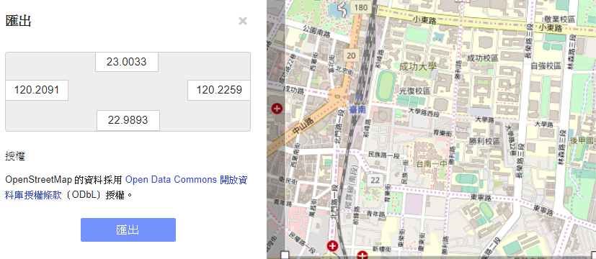
Create a new map in Tainan

Slide 15
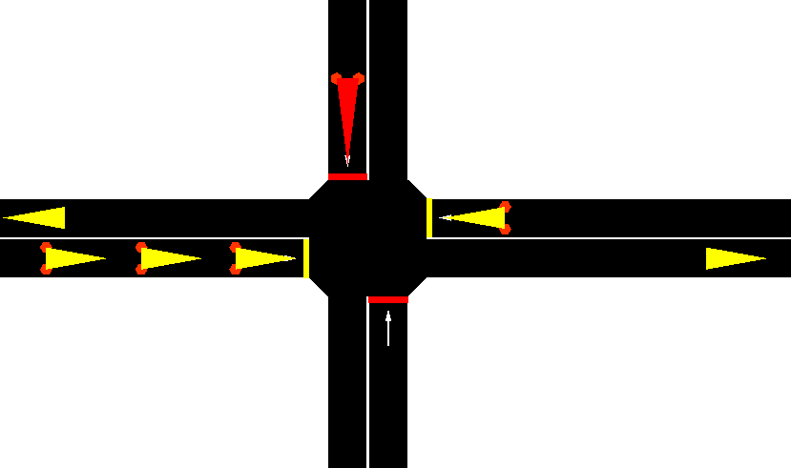
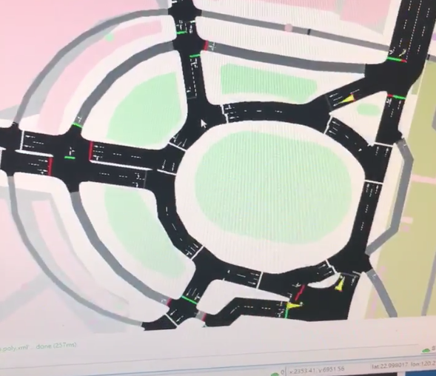
Generate random cars

Slide 16
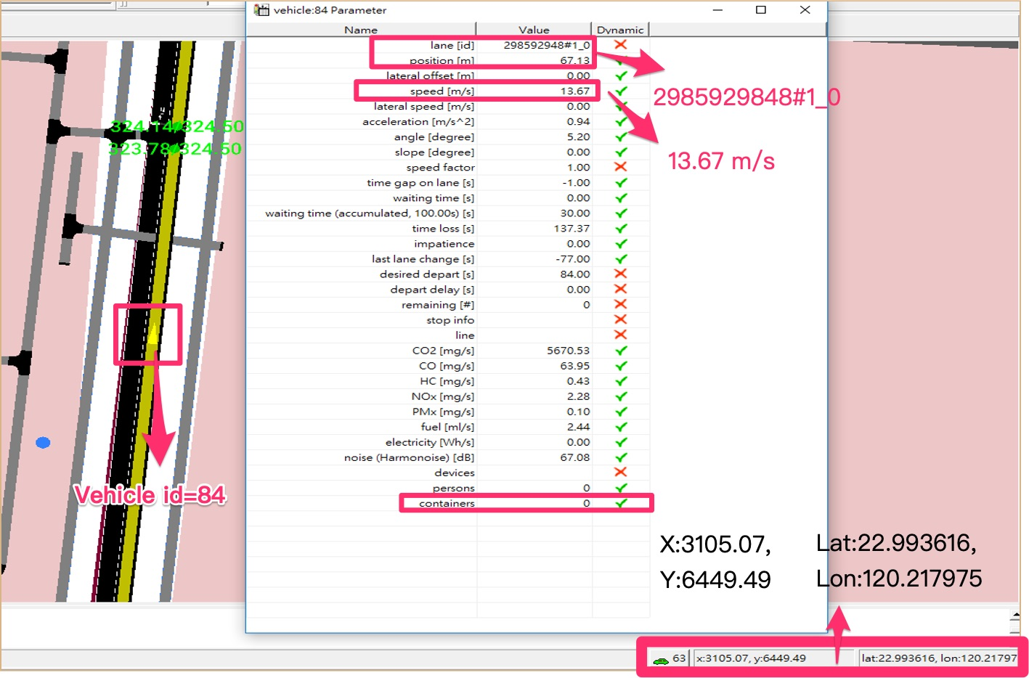
Label the Car of ID, Velocity and Position

Slide 17
Send Car Information to Web Server periodically
<timestep time="0.00"> <vehicle id="flow0.0" x="120.227513" y="22.982579" speed="0.000000" pos="5.100000" lane="307244665#2_0" />
</timestep> <timestep time="1.00"> <vehicle id="flow0.0" x="120.227502" y="22.982587 speed="1.441689" pos="6.541689" lane="307244665#2_0" />
</timestep> <timestep time="2.00"> <vehicle id="flow0.0" x="120.227479" y="22.982604" speed="3.115447" pos="9.657136" lane="307244665#2_0" />
Car Information includes time-step, vehicle id, geo-position and lane id.

Slide 18
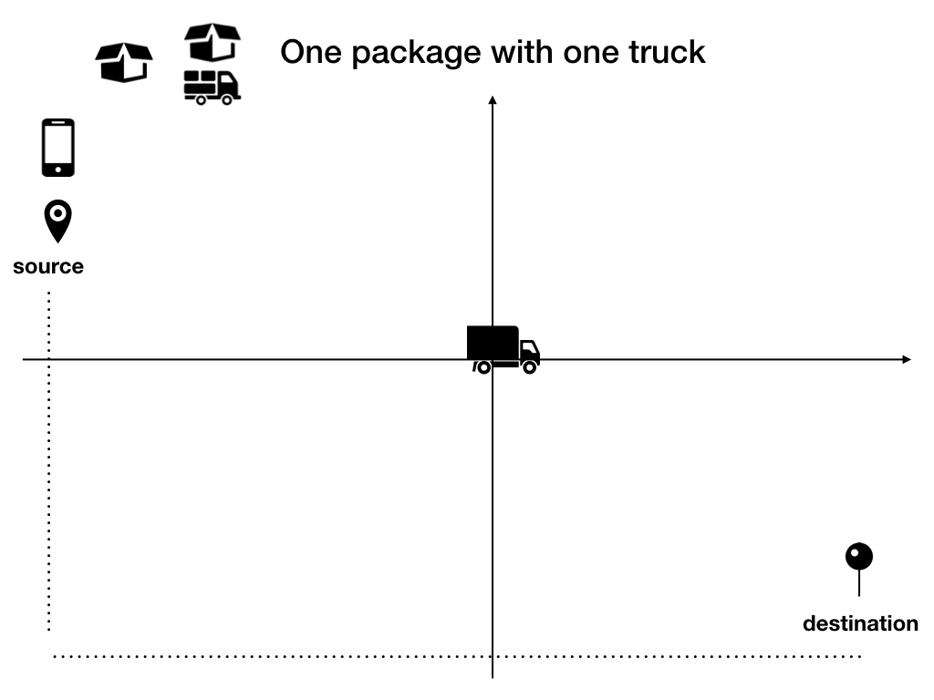
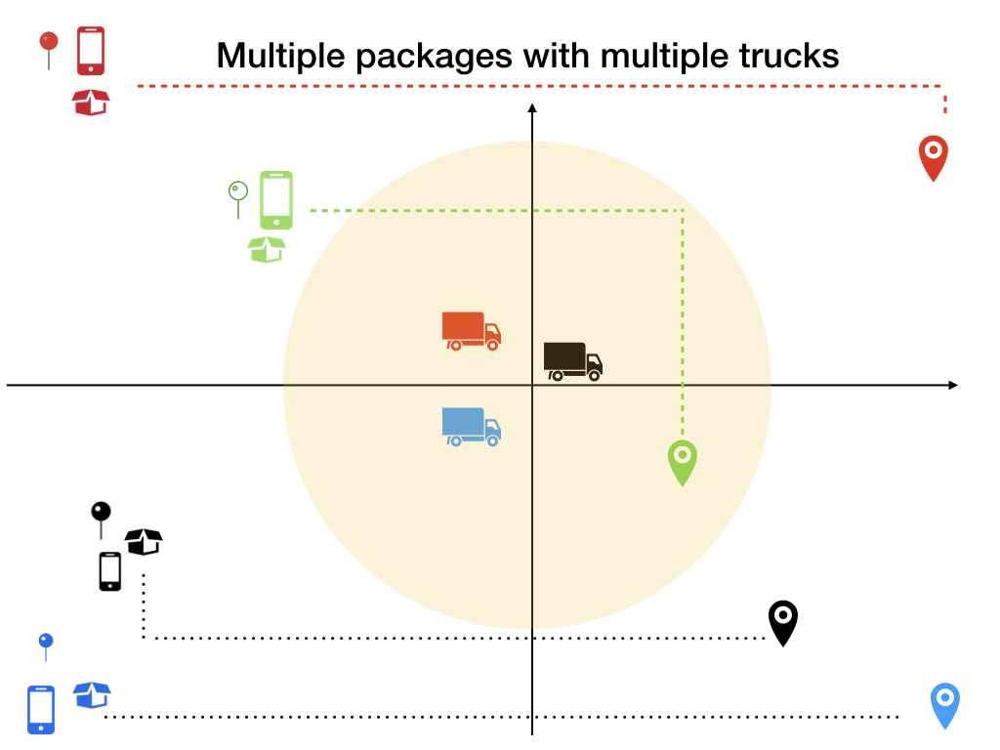
Receive the Command from Server and Dispatch the Suitable Car to User's Location
Arrange the route
Send GPS start end position
Send request via web service

Slide 19
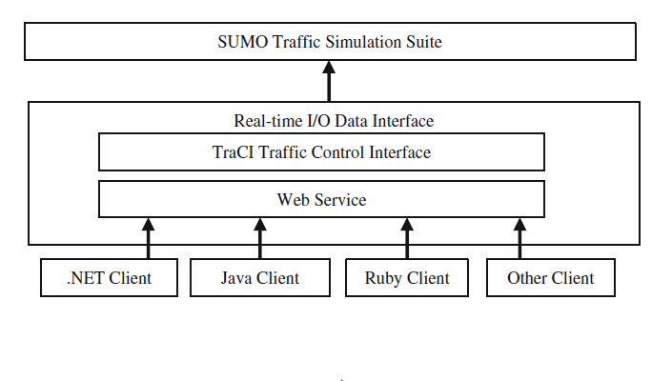
Concept of the Web Service
Arrange the route
GPS start end position

Slide 20
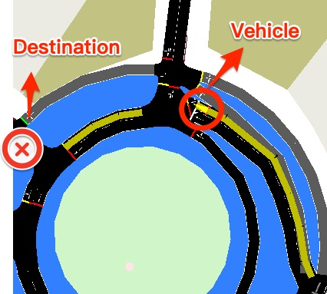
Export the coming signals when the car arrived the destination
arrival signals
coming signals
Server傳送橫幅通知給
Receiver，告知貨車已到達收件地址

Slide 21
Time Schedule
 | 二月 | 三月 | 四月 | 五月 | 六月 | 七月
Android UI + 資料庫建立 + Android API connecting to Server
SUMO 文檔閱讀 ＋ TraCI 研讀 ＋ 模擬環境參數設計與建立
利用 TraCI 設計 Server 與模擬環境之間的 API
Web Server 的派遣演算法設計
整合 Android, Server, SUMO
論文

Slide 22
Related Work
Krumnow, Mario. "Sumo as a Service–Building up a Web Service to Interact with SUMO." Simulation of Urban MObility User Conference. Springer, Berlin, Heidelberg, 2013.

